Slide 1
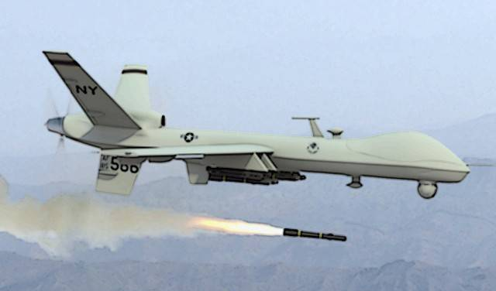
“Death by algorithm: the age of killer robots is closer than you think” (vox.com Jun-19)
3.8 Autonomous warfare - are there ever situations where it could be condoned?
We’d like you to consider whether there are ever any situations whereby autonomous weapons could be used reliably and also what international agreements would be needed to prevent warfare turning into “killer robots”.

Slide 2
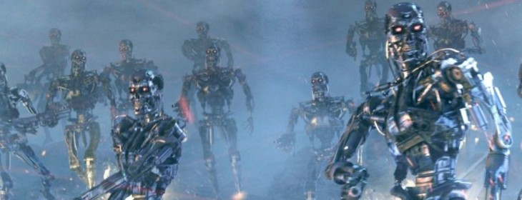
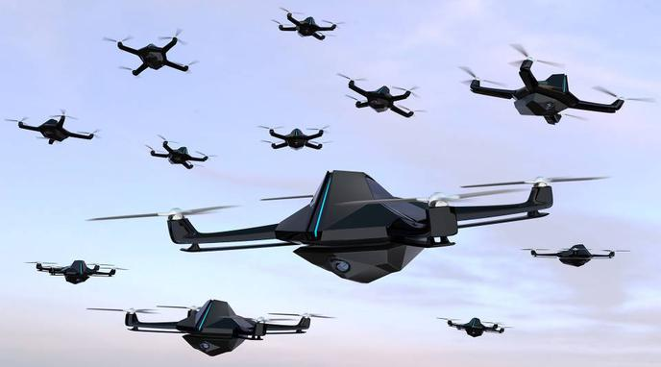
“We have the technology to make robots that kill without oversight. But should we?” (vox.com Jun-19)

Slide 3
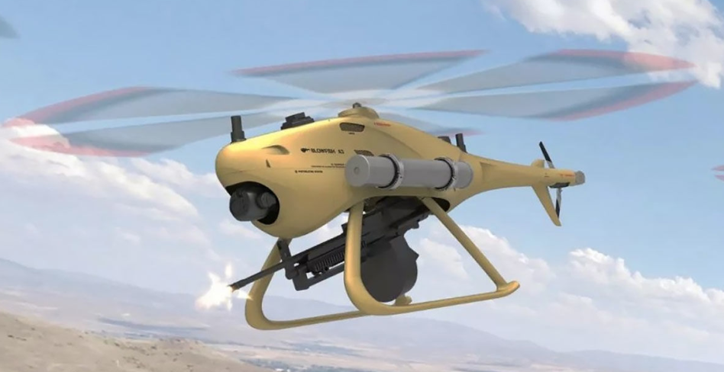
It’s no longer science fiction...
Chinese military contractors have already started to sell autonomous killer robots to customers in the Middle East.
How might an algorithm autonomously identify a “target”?
It could have a fixed list of people it can target and fire only if it’s highly confident (from its video footage) that it has identified a target
It could be trained, from footage of combat, to predict whether a human would tell it to fire, and fire if it thinks that’s the instruction it would be given
It could be taught to fire on anyone in a war zone holding something visually identifiable as a gun and not wearing the uniform of friendly forces
Blowfish A3 (manufactured by Ziyan)
Autonomous helicopter-like drone armed with a machine gun
“Autonomously performs more complex combat missions, including fixed-point timing detection, fixed-range reconnaissance, and targeted precision strikes” (Ziyan)

Slide 4
Are there perceived advantages for using “lethal autonomous weapons”?
Consider a strategic example:
An army wants to take a city but doesn’t want troops to get bogged down in door-to-door fighting as they fan out across the urban area
Instead, it sends in a flock of thousands of small drones, with simple instructions: Shoot everyone holding a weapon. A few hours later, the city is safe to enter
The most interesting argument for autonomous weapons, is that robots can be more ethical:
Humans sometimes commit war crimes, deliberately targeting innocents or killing people who’ve surrendered
Humans get fatigued, stressed, and confused, and end up making mistakes
Robots, by contrast, exactly follow their code and never get angry or seek revenge

Slide 5
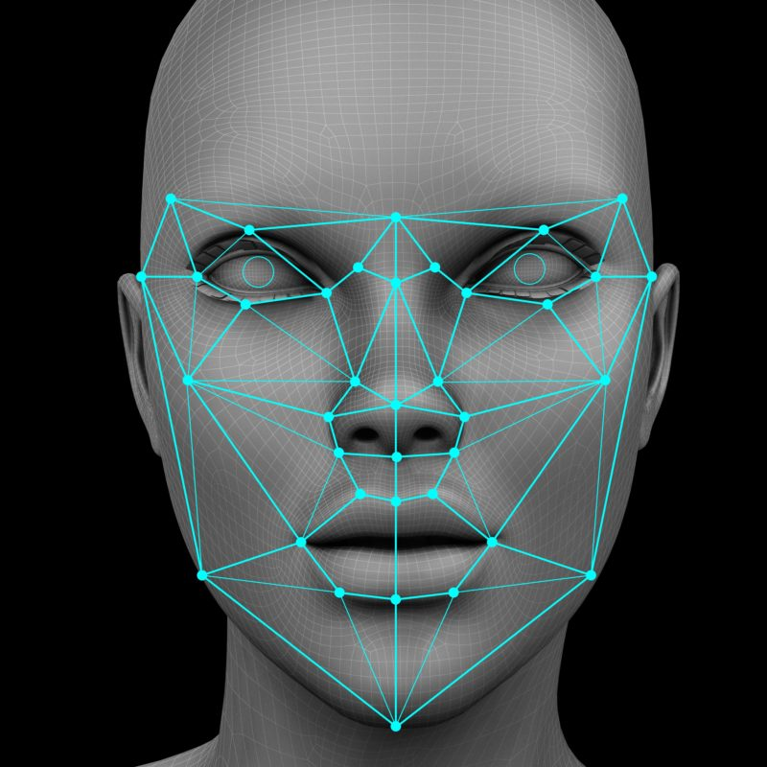
Are these weapons reliable?
In the past few years, the state of AI has grown by leaps and bounds
Facial recognition and object recognition technology has got vastly more accurate. Both would likely be essential for lethal autonomous weapons
New techniques have enabled AI systems to make instantaneous tactical decisions in online war games, meaning these weapons have rapidly gone from impossible to straightforward

Slide 6
Why are these weapons considered a bad idea?
Researchers in AI and public policy are trying to make the case that killer robots aren’t just a bad idea in the movies — they’re also a bad idea in real life
Fully autonomous weapons would also usher in a host of new moral, technical, and strategic dilemmas
Fully autonomous weapons will make it easier and cheaper to kill people — a serious problem all by itself in the wrong hands
Scientists and activists have pushed the United Nations and world governments to consider a preemptive ban

Slide 7
What about an international agreement?
The UN has been slow to agree even to a debate over a lethal autonomous weapons treaty
There are two major factors at play:
First, the UN’s process for international treaties is generally a slow and deliberative one, while rapid technological changes are altering the strategic situation with regard to lethal autonomous weapons faster than that process is set up to handle
Second, and probably more importantly, the treaty has some strong opposition
The US (along with Israel, South Korea, the United Kingdom, and Australia) has thus far opposed efforts to secure a UN treaty opposing lethal autonomous weapons
With the US opposed, an international treaty against lethal autonomous weapons is unlikely to succeed
References:
https://www.vox.com/2019/6/21/18691459/killer-robots-lethal-autonomous-weapons-ai-war
https://www.defenseone.com/technology/2019/11/secdef-china-exporting-killer-robots-mideast/161100/

